Slide 1
PCF Internals
Date: Apr 2017
Ver. 0.1
HSBC Technology and Services

Slide 2
Agenda
Need for PCF
Open Source, PaaS with Underlying IaaS, Cost Saving, Time to market, App Scalability, Low Deployment Effort, Traditional Monolithic Application issues
Difference between CF and PCF
Enterprise Grade, Tech Support, Enterprise Connectors/Services
PCF Availability As Public Cloud (http://run.pivotal.io), Private Cloud (In-Premise HSBC)
Light-weight PCF Local Installation - https://network.pivotal.io/products/pcfdev
PCF CF CLI
CF CLI Command Execution Chain
PCF Internal Architecture
DEA, Cloud Controller, Router, Health Manager, BOSH
PCF BuildPacks
Types of BuildPacks, Custom/Shelf BuildPacks, cf buildpacks, cf create-buildpack, cf update-buildpack
PCF Logs
Loggregator, Log commands
PCF Services, Market place
UPS, Managed Services, Service Bindings,DB services,Spring Cloud Connectors,VCAP_SERVICES, cf cups svc_name –p { },cf bind-service a s
PCF App Scalability, Demo
Horizontal, Vertical Scaling, cf scale app_name –k 5G, cf scale app_name –m 2G
Application Design For PCF Compatibility
12 Factor App (http://12factor.net), No JNDI, No File System Access
Target Architecture
Eureka, Spring Boot, Spring Cloud, Spring Config Server, Ribbon, Hystrix, Zuul

Slide 3
CF Push Workflow
DEA component (Droplet Execution Agent) is responsible for selecting buildpacks and staging the droplet. The request is first received by PCF CloudController component which has a database of all Orgs, Spaces, instances etc. CloudController interacts with HealthManager to get information on health of deployed apps.
Pivotal OpsManager is a web application that we use to deploy and manage a Pivotal CF PaaS. BOSH agent is installed on all the PCF VMs. BOSH controls the VM creation and interacts with the underlying IaaS.

Slide 4
PCF Overall Architecture
Virtual Machine
Infra Orchestrator
IaaS
CF Commands
BOSH
Droplet Execution Agent
Sniff Droplet
Download BuildPack
Install App
AWS
Cloud Controller
Droplet Execution Agent
Droplet
OpenStack
Droplet Execution Agent
VMWare vSphere
Web Console
Pivotal Ops Manager
Pivotal Apps Manager

Slide 5
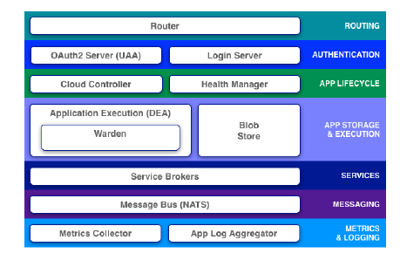
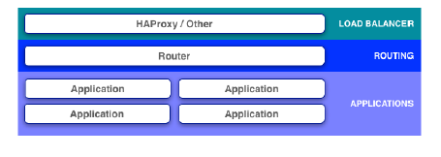
PCF Internal Logical Architecture
Http requests
HAProxy is the load balancer and is not production grade
HAProxy can be managed via OpsManager and a new one can be
configured

Slide 6
Thank You

